Slide 1

Streamlit Powered Data Science Visualizing Crypto currency Markets
Department of Computer Science and Engineering Seshadri Rao Gudlavalleru Engineering College, Gudlavalleru
Presented By:Team B17
K.Koteswararao K.Ganesh
J.Keerthi Lahari
K.Venkata Kalyani G.Thanmai Teja
21481A0598
21481A0599
21481A0584
21481A05A5
21481A0570
Under the guidance of
Mr. U. Vinod Kumar, M. Tech
Assistant Professor, Department of CSE

Slide 2

CONTENTS
Abstract
Related Work
Problem Statement
Objective
Proposed System
Methodology
Implementation
Results
Conclusion

Slide 3
Abstract
Cryptocurrency markets are highly volatile, requiring efficient tools for real- time analysis and visualization.
This project develops a web-based cryptocurrency visualization platform using Streamlit, eliminating the need for traditional web development.
Data is extracted from CoinMarketCap using BeautifulSoup (bs4) and cryptocmd, then processed with Pandas for accuracy.
The application is deployed on Google Cloud Shell, ensuring accessibility without local installations.

Slide 4
Related Work
The Cryptocurrency analysis and visualization using Python and Streamlit is a multifaceted project thatmerges data exploration, cryptography, and interactive presentation techniques.
Python, with its comprehensive suite of libraries like Pandas, NumPy, and Matplotlib,offers a robust ecosystem for data manipulation and visualization, rendering it an ideal platform forthis endeavor.
To commence the analysis, data acquisition and preprocessing are paramount. This involves sourcingdata from APIs provided by cryptocurrency exchanges, blockchain explorers, or historical datarepositories.

Slide 5
Sentiment analysis constitutes another integral aspect of cryptocurrency analysis. By scrutinizing social media posts, news articles, and forum discussions, analysts can gauge public sentiment towards various cryptocurrencies.
Regression models, time series analysis, and clustering algorithms can be leveraged to uncover patterns within cryptocurrency data.
Streamlit emerges as a pivotal component for crafting interactive visualizations and dashboards to showcase cryptocurrency analysis results.
With its intuitive interface and declarative syntax, Streamlit facilitates the rapid prototyping and deployment of data-driven applications.

Slide 6
Problem Statement
Cryptocurrency markets are highly volatile, with prices fluctuating rapidly due to various factors such as market demand, regulations, and investor sentiment.
This project aims to develop a lightweight, interactive, and user-friendly web application that provides real-time and historical cryptocurrency market analysis.
By utilizing web scraping (BeautifulSoup, cryptocmd) for data extraction, Pandas for processing, and visualization tools like Matplotlib and Seaborn, the system enables users to analyze market trends efficiently.
The application is built using Streamlit and deployed on Google Cloud Shell, eliminating the need for traditional web development while ensuring accessibility and scalability.

Slide 7
Objective
Develop a User-Friendly Web Application
Real-Time & Historical Data Extraction
Data Processing & Cleaning
Interactive Data Visualization
Cloud-Based Deployment
Enhance Decision-Making for Users

Slide 8
Proposed System
The project "Crypto Analysis and Visualization using Python and Streamlit" aims to revolutionize cryptocurrency analysis and visualization by offering a cutting-edge solution to address existing challenges.
Key features of the proposed system include comprehensive data analysis and visualization tools powered by Python, Streamlit, Matplotlib, Seaborn, and Base64.
Furthermore, the project integrates educational resources, providing insights into cryptocurrency trends to enhance users' knowledge and understanding of the crypto market.
Hosted on Google Cloud Shell, the system ensures scalability and accessibility, enabling users to access the platform from diverse devices and locations.
Overall, "Crypto Analysis and Visualization using Python and Streamlit" presents a holistic solution to empower users in navigating the complexities of the cryptocurrency landscape.

Slide 9
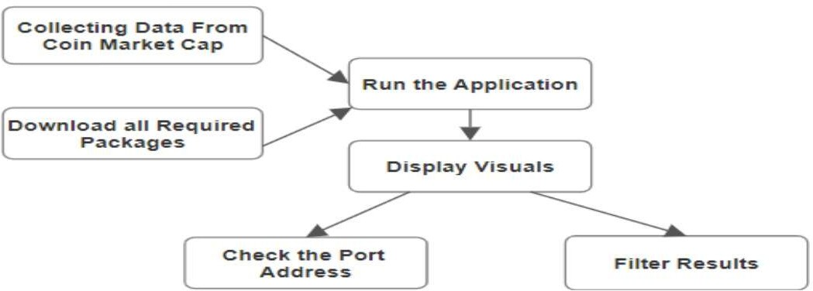
Process flow and Architecture

Slide 10
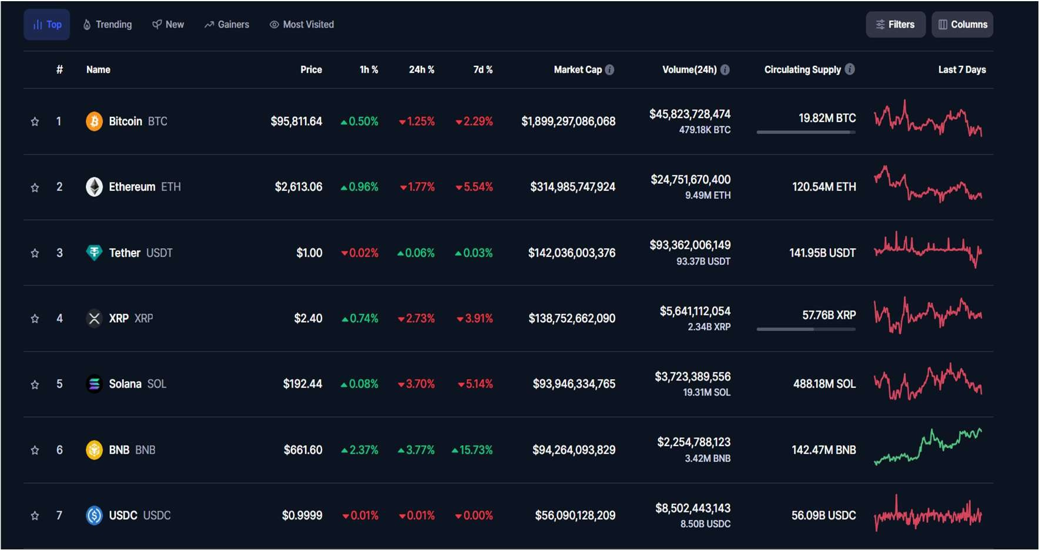
Data Set

Slide 11
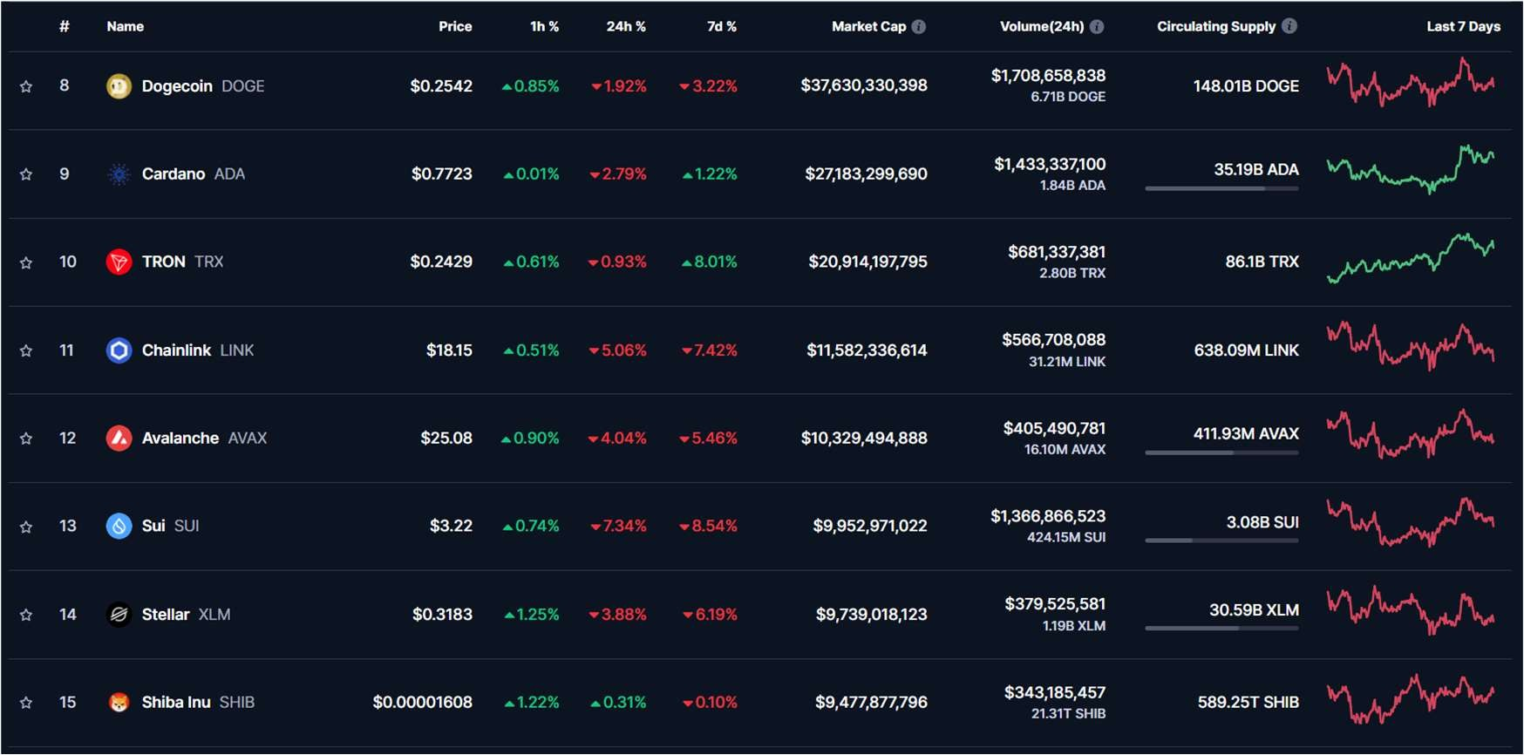
Data set

Slide 12
Methodology
Data Extraction
Data Processing
Data Visualization
User Interface & Interaction

Slide 13
Implementation
The implementation of the cryptocurrency market visualization web application involves five main stages: data extraction, data processing, data visualization, user interface design, and cloud deployment.
The entire system is built using Streamlit, Python, and various libraries like Pandas, Matplotlib, Seaborn, BeautifulSoup (bs4), and cryptocmd.
Data Extraction
Data Processing
Data Visualization
User Interface & Interaction
Cloud Deployment

Slide 14
1. Data Extraction
Tools Used: requests, BeautifulSoup (bs4), cryptocmd
Real-time data: Extracted from CoinMarketCap using web scraping.
Historical data: Fetched using cryptocmd, which retrieves historical cryptocurrency price data.
Process:
Send an HTTP request to CoinMarketCap.
Parse the HTML response using BeautifulSoup to extract relevant details (prices, market capitalization, volume).
Convert the extracted data into a structured Pandas DataFrame for further processing.
CoinMarketCap website url: https://coinmarketcap.com/

Slide 15
2.Data Processing
Tools Used: Pandas Cleaning Data:
Remove unnecessary characters from price values. Convert numerical data types.
Handle missing or inconsistent data.

Slide 16
3.Data Visualization
Tools Used: Matplotlib, Seaborn, Streamlit
Line Charts: Track cryptocurrency price trends over time.
Bar Charts: Compare market capitalization and trading volume. Heatmaps: Show correlations between different cryptocurrencies. Candlestick Charts: Represent market fluctuations.

Slide 17
4.User Interface & Interaction
Framework Used: Streamlit Interactive Widgets:
Dropdowns and sliders allow users to filter data. Real-time Visualization:
Dynamic charts update based on user input.

Slide 18
5.Cloud Deployment
Platform Used:
Google Cloud Shell
Application is hosted on Google Cloud for accessibility. No local setup required; runs directly in the cloud.

Slide 19
Deployment steps
Install Streamlit and other libraries in Google Cloud Shell:
pipenv install streamlit pandas matplotlib seaborn bs4 cryptocmd
Run the application:
streamlit run appname.py --server.port 8080 -- browser.serverAddress [server address]
(streamlit run crypto_price_app.py --server.port 8080 --browser.serverAddress https://8080-cs-507449746201-default.cs-asia-southeast1- ajrg.cloudshell.dev/?authuser=0&redirectedPreviously=true)

Slide 20
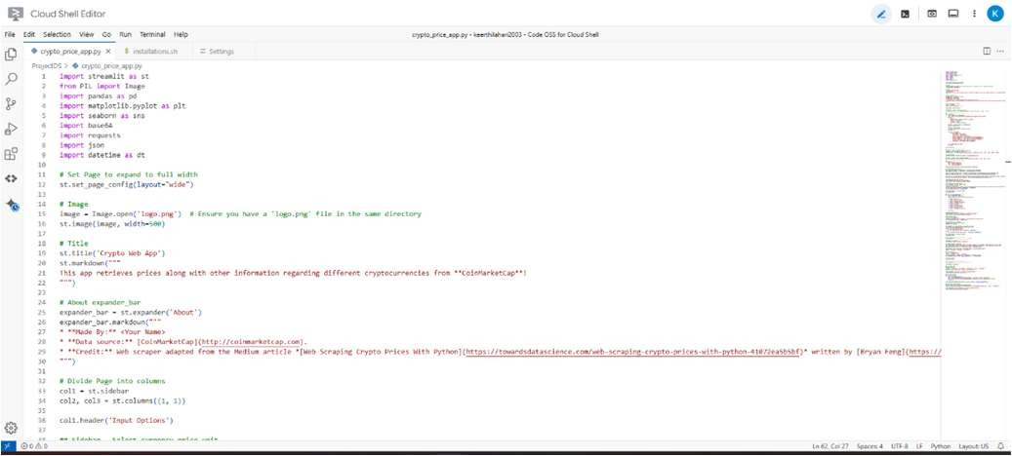
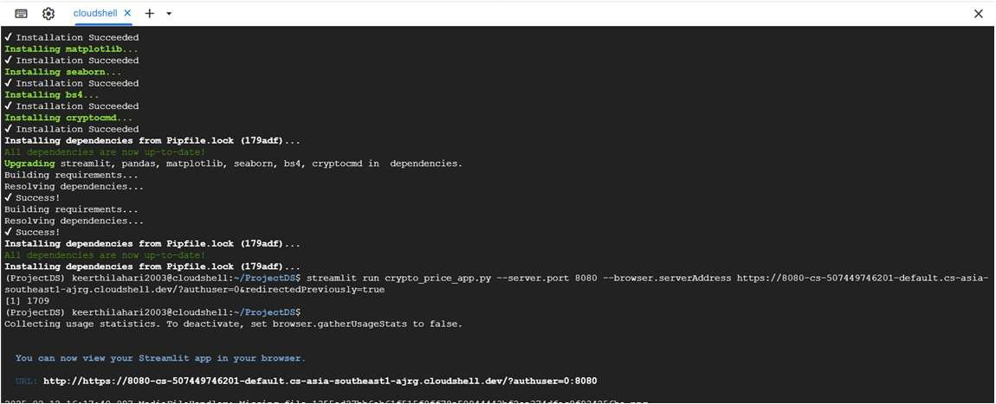
Execution and Results

Slide 21
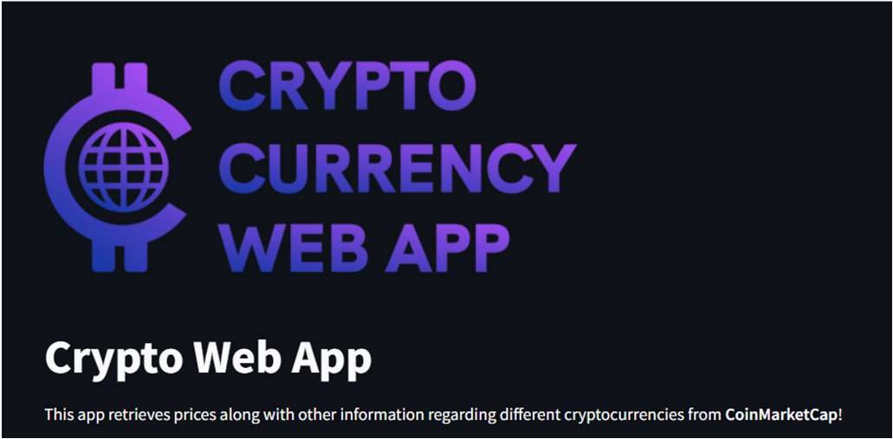
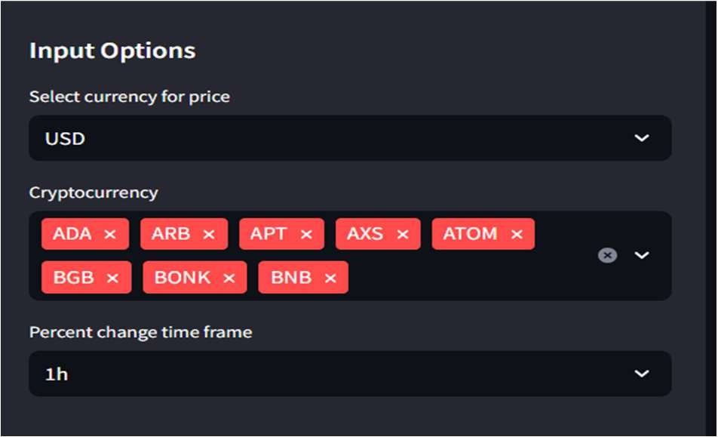
Results

Slide 22
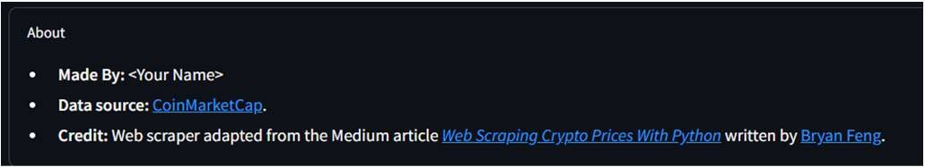
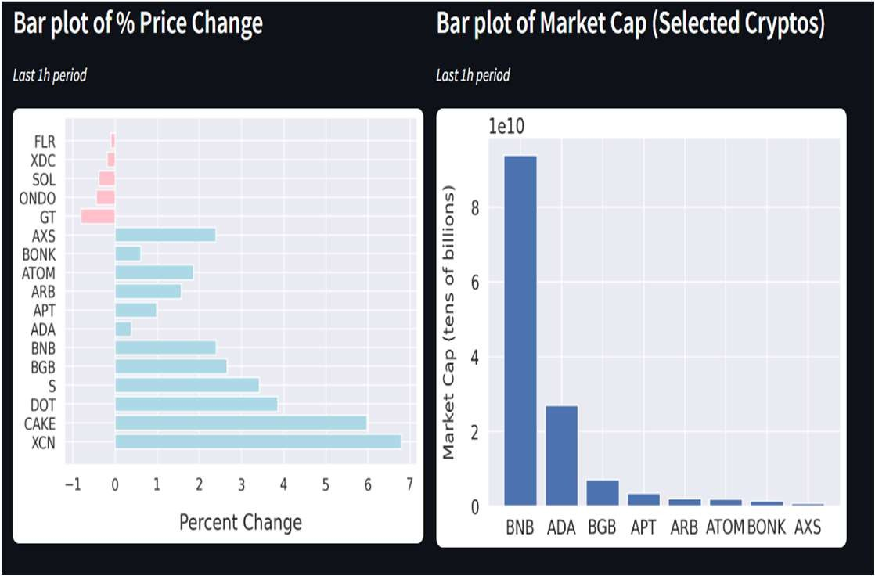
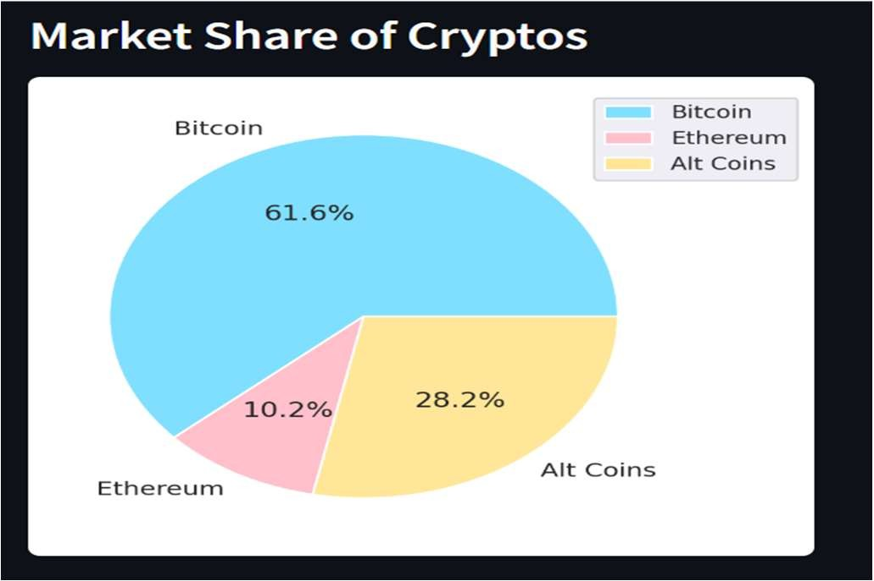
Results

Slide 23
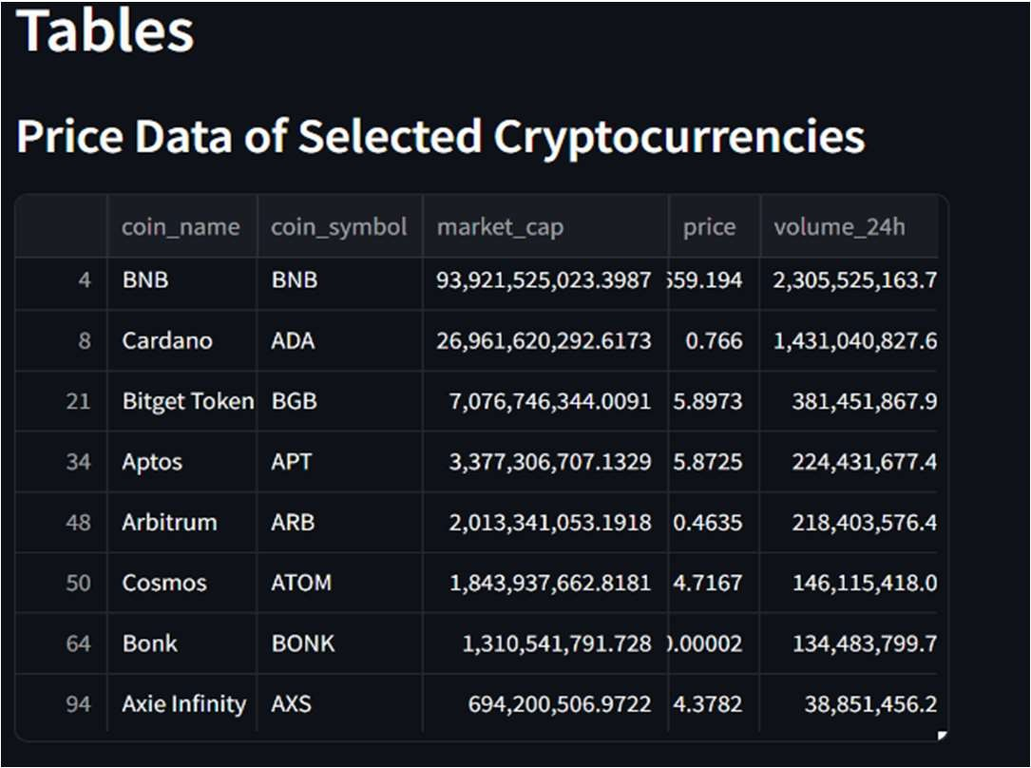
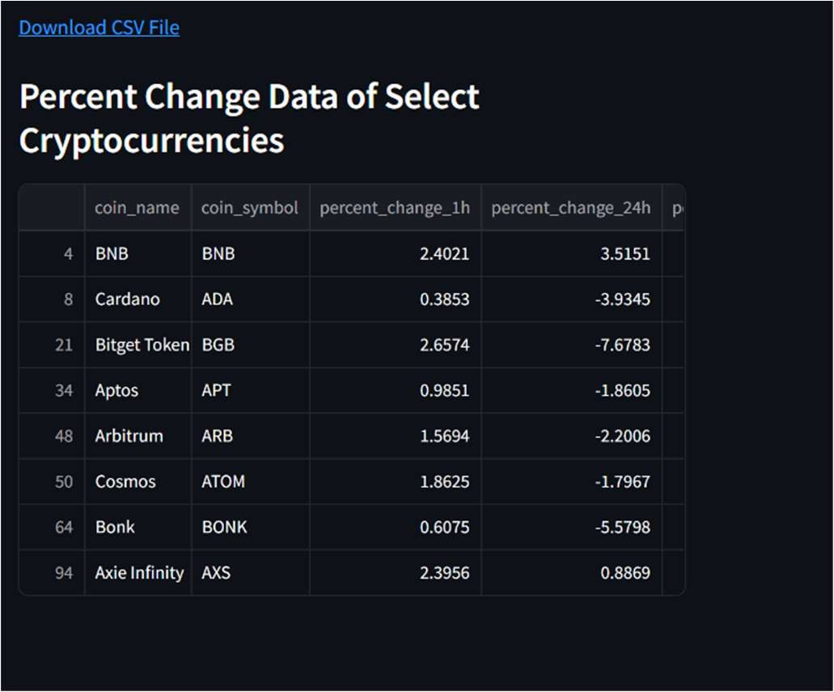
Results

Slide 24
Conclusion
The integration of Python and Streamlit provides a powerful toolkit for crypto analysis and visualization.
Streamlit's user-friendly interface further enhances the experience by facilitating dynamic dashboard creation and real-time data exploration.
By offering accessible and interpretable crypto market insights, this integration empowers users to make informed decisions in the fast-paced and dynamic world of cryptocurrency trading.

Slide 25
Thank You!

